Slide 1
PARKINSON’S DISEASE DETECTION
By:
Sai Teja Karlapudi
Sai Saketh Kambalapally

Slide 2
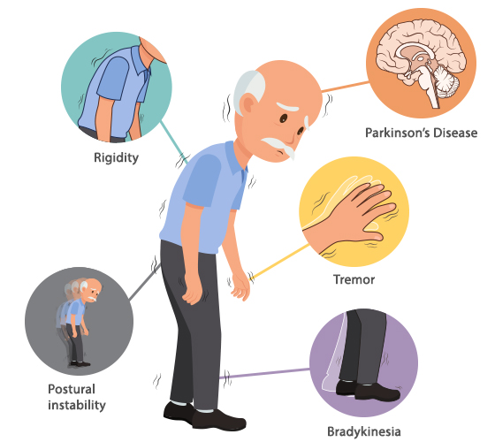
Introduction:
Parkinson’s Disease (PD) is a chronic neurologic condition that affects both motor and non-motor neural circuits.
Speech deterioration is a common symptom, which often presents early in the disease course.
This helps the doctors to improve accuracy in diagnostics using voice recordings which involves less cost and non-invasive testing.
Machine Learning algorithm(s) helps in detecting Parkinson’s disease with higher accuracy using the dataset consisting of the speech features.
Source: https://neurologysleepcentre.com

Slide 3
Column Names | Description
Name | ASCII subject name and recording number
MDVP:Fo(Hz) | Average vocal fundamental frequency
MDVP:Fhi(Hz) and MDVP:Flo(Hz) | Maximum and Minimum vocal fundamental frequency.
MDVP:Jitter(%), MDVP:Jitter(Abs), MDVP:RAP, MDVP:PPQ, Jitter:DDP | Several measures of variation in fundamental frequency
MDVP:Shimmer, MDVP:Shimmer(dB), Shimmer:APQ3, Shimmer:APQ5, MDVP:APQ, Shimmer:DDA | Several measures of variation in amplitude
NHR, HNR | Two measures of ratio of noise to tonal components in the voice
Status | Health status of the subject (one) - Parkinson's, (zero) - healthy
RPDE,D2 | Two nonlinear dynamical complexity measures
DFA | Signal fractal scaling exponent
spread1,spread2,PPE | Three nonlinear measures of fundamental frequency variation

Slide 4
Data Loading
Dataset consists of 195 columns and 24 features. No missing values were found in the dataset.
Pre-Processing
Steps followed:
Downloaded the data set from UCI Machine Learning Repository and load it in data frame using pandas library.
The data is preprocessed by performing Exploratory Data Analysis and using the MiniMax Scaler.
The dataset is divided into training data and testing data and the model is created, which is trained with training data.
The trained model then tested using test data set to make prediction and calculate the accuracy metrics.
Data Splitting
Building Model
Testing Model

Slide 5
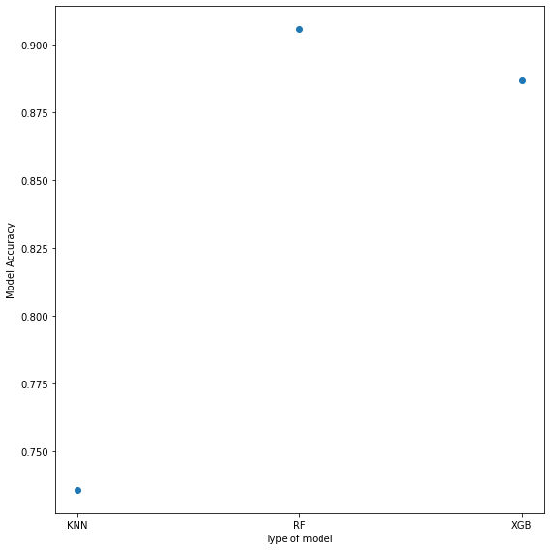
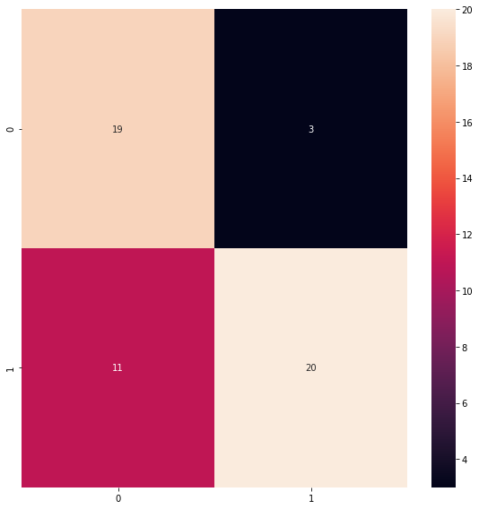
Results
KNN = 73.58%
Random Forest = 90.56%
XGB = 88.67%
KNN Confusion Matrix Heat map

Slide 6
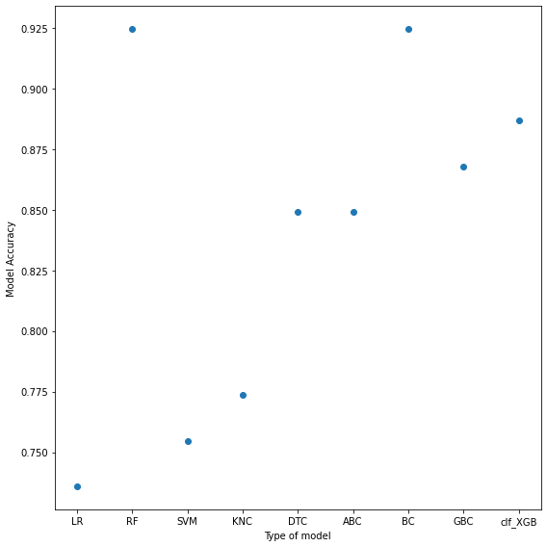
5 Fold Cross Validation
5 Fold Cross Validation Results:
Logistic Regression and SVM = 73.58% and 75.45% respectively.
Random Forest and Bagging = 92.45%
K Neighbors and XG Boost = 77.36% and 88.68% respectively.
Decision Tree , Gradient Boost and Ada Boost = 84.91%, 86.79%, and 84.91% respectively.
Ensemble method is used by adding Adda Boost and XG Boost as layer 1 and K Neighbors as layer 2.
Testing accuracy of 88.67% is acquired using Ensemble.

Slide 7
Thank you…..

